Slide 1
Chapter 10:
Classes and Data Abstraction
PART I

Slide 2
Objectives
In this chapter, you will:
  Learn about classes
  Learn about private, protected, and public members of a class
  Explore how classes are implemented
  Become aware of accessor and mutator functions
  Examine constructors and destructors
C++ Programming: From Problem Analysis to Program Design, Seventh Edition

Slide 3
Objectives (cont’d.)
  Learn about the abstract data type (ADT)
  Explore how classes are used to implement ADTs
  Become aware of the differences between a struct and a class
  Learn about information hiding
  Explore how information hiding is implemented in C++
  Learn about the static members of a class
C++ Programming: From Problem Analysis to Program Design, Seventh Edition

Slide 4
Objects in Real Environment
Everything surrounded us is an object.
An object is animate or inanimate
  Animate objects: human, animal.
  Inanimate objects: car, football, door, etc.
Objects either animate and inanimate have:
  Behavior (Human: think, eat, drink, sleep, etc.)
  Attributes (Human: name, age, weight, etc.)
C++ Programming: From Problem Analysis to Program Design, Seventh Edition

Slide 5
Objects in Real Environment (cont’d.)
Objects communicate with each other via sending message
  Example: a sergeant commanding a soldier to stand at attention
The communication between objects is performed using object interfaces
  Examples: (Door: handle, Car: steering wheel, Human: mouth/ears)
There are different relationships between objects
  Inheritance
  Composition
C++ Programming: From Problem Analysis to Program Design, Seventh Edition

Slide 6
Objects in Real Environment (cont’d.)
Objects hide their internal details from surrounding environment for two reasons:
  To protect object contents from tampering
    Example1: human skin protect the body human against versus, sunlight, air, radiation, etc.
  To easily use an object without paying attention to object details (internal implementation)
    Example2: you can drive a car effectively without knowing the details of how the engine system work internally
C++ Programming: From Problem Analysis to Program Design, Seventh Edition

Slide 7
Object-Oriented Programming (OPP)
OOP models real-objects with software counterparts
  OOP models real-world objects’ attributes and behavior.
  OOP models communication between real-world objects.
  OOP models relationships between real-world objects.
OOP encapsulates data (attributes) and methods (behavior) into a package called object
This encapsulation is called information hiding
  Information hiding means hiding the internal implementation of an object against the real environment.
C++ Programming: From Problem Analysis to Program Design, Seventh Edition

Slide 8
Classes and Objects
To model real-world objects we should use classes and objects
  A class is a blueprint for objects
  An object is an instantiation (example) of a class
  The relationships between class and object is the same relationship between house blueprint and the physical house
A class consists of a set of components each one called member
C++ Programming: From Problem Analysis to Program Design, Seventh Edition

Slide 9
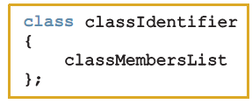
Classes and Objects (cont’d.)
Class definition:
  Defines a data type; no memory is allocated
  Don’t forget the semicolon after the closing brace
Syntax:
C++ Programming: From Problem Analysis to Program Design, Seventh Edition

Slide 10
Classes (cont’d.)
Class member can be a variable or a function
If a member of a class is a variable
  It is declared like any other variable
  You cannot initialize a variable when you declare it
If a member of a class is a function
  Function prototype is listed
  Function members can (directly) access any member of the class
C++ Programming: From Problem Analysis to Program Design, Seventh Edition

Slide 11
Classes (cont’d.)
Three categories of class members:
  private (default)
    Member cannot be accessed outside the class
  public
    Member is accessible outside the class
  protected
C++ Programming: From Problem Analysis to Program Design, Seventh Edition

Slide 12
Variable (Object) Declaration
Once defined, you can declare variables of that class type
Point p1;
A class variable is called a class object or class instance
C++ Programming: From Problem Analysis to Program Design, Seventh Edition

Slide 13

Accessing Class Members
Once an object is declared, it can access the public members of the class
Syntax:
  The dot (.) is the member access operator
If an object is declared in the definition of a member function of the class, it can access the public and private members
C++ Programming: From Problem Analysis to Program Design, Seventh Edition

Slide 14
Built-in Operations on Classes
Most of C++’s built-in operations do not apply to classes
  Arithmetic operators cannot be used on class objects unless the operators are overloaded
  Cannot use relational operators to compare two class objects for equality
Built-in operations that are valid for class objects:
  Member access (.)
  Assignment (=)
C++ Programming: From Problem Analysis to Program Design, Seventh Edition

Slide 15
Implementation of Member Functions
Must write the code for functions defined as function prototypes
Prototypes are left in the class to keep the class smaller and to hide the implementation
To access identifiers local to the class, use the scope resolution operator ::
C++ Programming: From Problem Analysis to Program Design, Seventh Edition

Slide 16
Implementation of Member Functions (cont’d.)
Once a class is properly defined and implemented, it can be used in a program
  A program that uses/manipulates objects of a class is called a client of that class
When you declare objects of the class Point, each object has its own copy of the member variables (x and y)
  Called instance variables of the class
  Every object has its own instance of the data
C++ Programming: From Problem Analysis to Program Design, Seventh Edition

Slide 17
Accessor and Mutator Functions
Accessor function: member function that only accesses the value(s) of member variable(s)
Mutator function: member function that modifies the value(s) of member variable(s)
C++ Programming: From Problem Analysis to Program Design, Seventh Edition

Slide 18
Order of public and private Members of a Class
C++ has no fixed order in which to declare public and private members
By default, all members of a class are private
Use the member access specifier public to make a member available for public access
C++ Programming: From Problem Analysis to Program Design, Seventh Edition

Slide 19
Constructors
Use constructors to guarantee that member variables of a class are initialized
Two types of constructors:
  With parameters
  Without parameters (default constructor)
  Name of a constructor = name of the class
  A constructor has no type
C++ Programming: From Problem Analysis to Program Design, Seventh Edition

Slide 20
Constructors (cont’d.)
A class can have more than one constructor
  Each must have a different formal parameter list
Constructors execute automatically when a class object enters its scope
They cannot be called like other functions
Which constructor executes depends on the types of values passed to the class object when the class object is declared
C++ Programming: From Problem Analysis to Program Design, Seventh Edition

Slide 21
Invoking a Constructor
A constructor is automatically executed when a class variable is declared
Because a class may have more than one constructor, you can invoke a specific constructor
C++ Programming: From Problem Analysis to Program Design, Seventh Edition

Slide 22

Invoking the Default Constructor
To invoke the default constructor:
Example:
clockType yourClock;
C++ Programming: From Problem Analysis to Program Design, Seventh Edition

Slide 23
Invoking a Constructor with Parameters
Syntax:
Number and type of arguments should match the formal parameters (in the order given) of one of the constructors
  Otherwise, C++ uses type conversion and looks for the best match
  Any ambiguity causes a compile-time error
C++ Programming: From Problem Analysis to Program Design, Seventh Edition

Slide 24
Constructors and Default Parameters
A constructor can have default parameters
  Rules for declaring formal parameters are the same as for declaring default formal parameters in a function
  Actual parameters are passed according to same rules for functions
Default constructor: a constructor with no parameters or with all default parameters
C++ Programming: From Problem Analysis to Program Design, Seventh Edition

Slide 25
Classes and Constructors: A Precaution
If a class has no constructor(s), C++ provides the default constructor
  However, object declared is still uninitialized
If a class includes constructor(s) with parameter(s), but not the default constructor
  C++ does not provide the default constructor
C++ Programming: From Problem Analysis to Program Design, Seventh Edition

Slide 26
Destructors
Destructors are functions without any type
The name of a destructor is the character '~' followed by class name
  For example:
~clockType();
A class can have only one destructor
  The destructor has no parameters
Destructor automatically executes when the class object goes out of scope
C++ Programming: From Problem Analysis to Program Design, Seventh Edition

Slide 27
Const Objects and Const Member Function
Constant Object
  Object is not modifiable
Constant function:
  Member function that cannot modify member variables
  Use const in function heading
C++ Programming: From Problem Analysis to Program Design, Seventh Edition

Slide 28
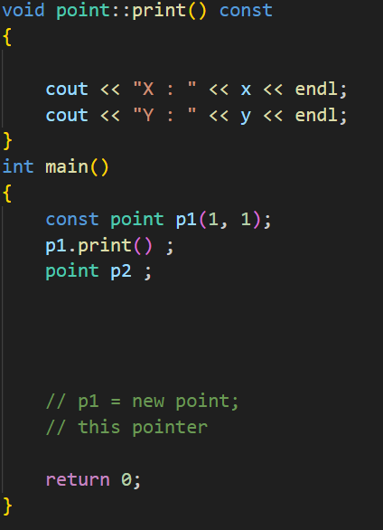
ملاحظة
const fanction الا const obj ما بتقدر تستدعي من
constractor الا عن طريق const obj ما بتقدرتدخل قيم
عن طريق اي اوبجكتconst fanctionلكن بتقدر تستدعي
You can’t add const fanction
Without class
شرط عضوا
C++ Programming: From Problem Analysis to Program Design, Seventh Edition

Slide 29
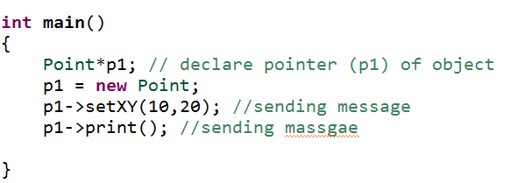
Pointer of Object
C++ Programming: From Problem Analysis to Program Design, Seventh Edition

Slide 30
The End
C++ Programming: From Problem Analysis to Program Design, Seventh Edition

